Slide 1
NATIONAL ASSOCIATION FOR BILINGUAL EDUCATION
FEBRUARY 2022 in New York
Angelina Aranda

Slide 2
What did we learn in NABE?
There were many workshops to choose from, but there was one of few that we are grateful for attending: INCLUSION, NOT EXCLUSION of Multilingual Learners with Disabilities in dual language programs. By Liliana Salazar / Director for Special Education and Support.
Did you know? That Special Ed and English Learners have many things and challenges in common? For example: being misdiagnose, delayed in retaining, not easy to adjust to a new climate, scared, afraid, intimidate, confused, no confidence, exhausted, etc. But the main common need is PROPER INTERVENTION!

Slide 3
FACTS: Code-switching, such as “SPANGLISH”, is normal and grammatical behavior of all DLLs/ELs, including those with disabilities, and it can help them communicate effectively. It is equally present in typically developing children and should NOT be interpreted as a sign of “language impairment.”
Did you also know that “ Teachers feel afraid to teach special Ed students because they feel they are not ready to help them properly?
63% of Education teachers did not received any formal or informational training on teaching students with learning disabilities
“Teachers might not know what INCLUSION really means.”
INCLUSION, by definition, involves carefully assessing a child’s needs and then implementing a strategic plan to support that child within the general classroom setting, it requires teachers, school, and the entire school system to commit to the model.
Inclusion works when educators collaborate, get the support they need and believe in the value of the students.
“Placement teachers do NOT properly diagnosed”

Slide 4
Recommendation for the SUSD:
Sign a contract with Liliana Salazar, Director for Special Education and Support.
Increase PASSIONATE/VOCATIONAL bilingual special ed staff.
Adult Education to understand the students needs, motivate, be thankful, and appreciate teachers.
The SUSD or any department that is charged of sending parents to these conferences, should take into consideration the dates of travel and return, since in our case, we missed the last day of the conference because we had the flight for the same day.
SUSD should be provide all the expenses prior to the trip, (food, transportation, hotel deposit, etc.) so parents do not need to worry about it.

Slide 5
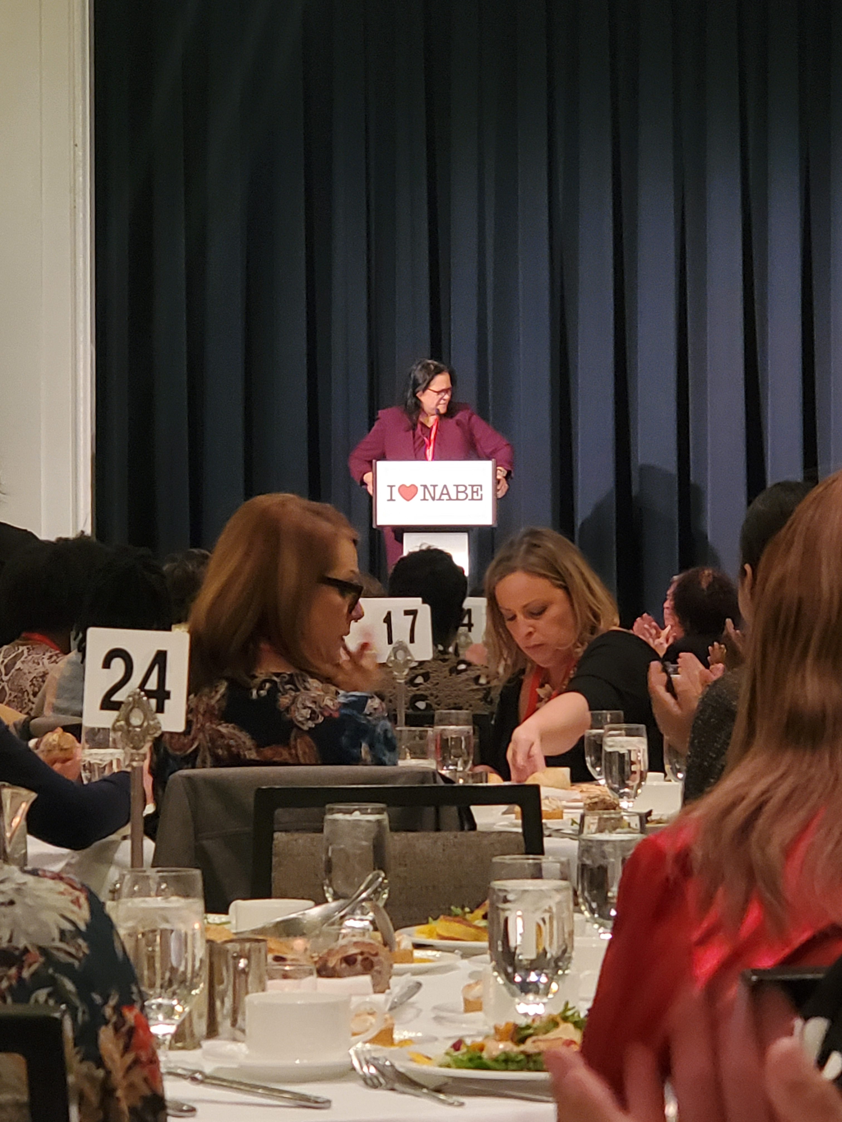
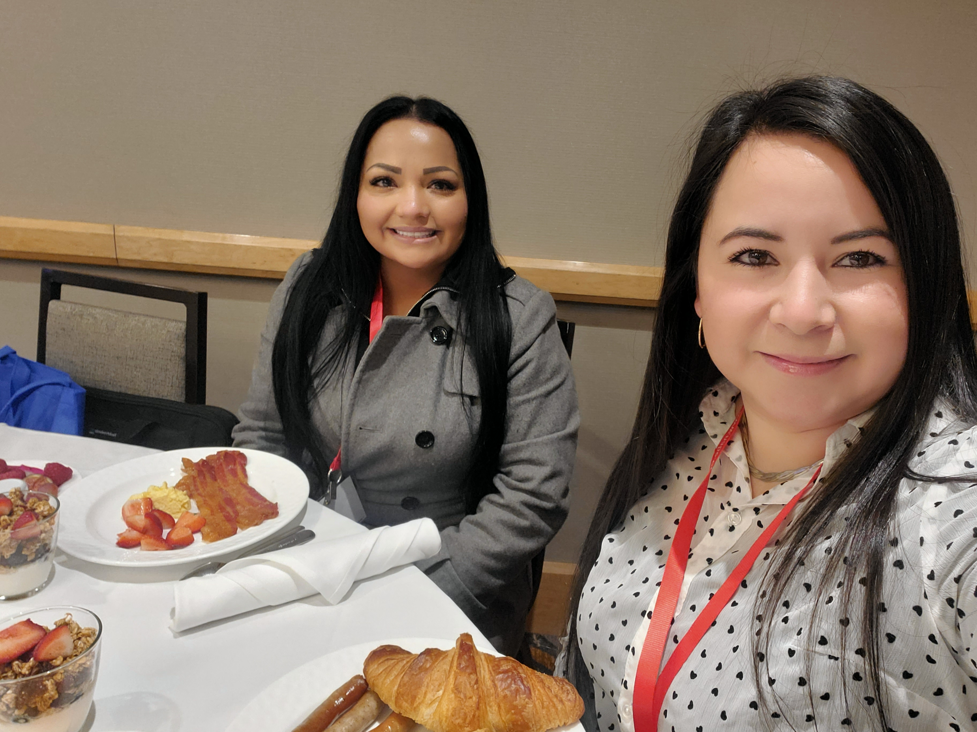
Thank You!

Slide 6
CALIFORNIA ASSOCIATION FOR BILINGUAL EDUCATION
Sandra Arreola

Slide 7
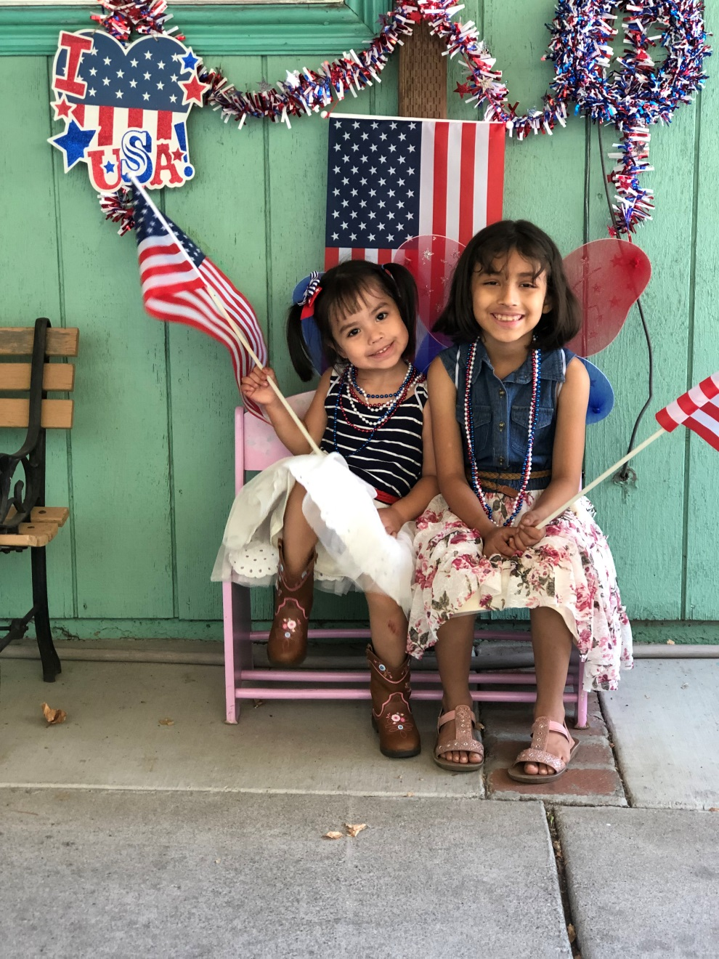
About my family/Acerca de mi familia

Slide 8
Empoderamiento propio y como dar voz a nuestros hijos: involucrar, desarrollo social y emocional (por Margarita Mosqueda)
En este taller aprendí que acontecimientos que hayan marcado mi infancia pueden ser acarreados a mi presente y marcar la vida de quien me rodea especialmente la de mis hijos, además que afectan mucho mi salud física, mental y espiritual.
Nuestros traumas de la infancia pueden ser transmitidos a nuestros hijos es por eso que hay que sanar para cortar con esa cadena.

Slide 9
7 pasos para criar a un gran triunfador (por: Dr. Nicoline Ambe)
Aprendí sobre estos pasos usando la palabra SUCCESS.
S=Set high expectations (se clara con tus hijos al comunicarte de las expectativas que esperas en su crecimiento académico.
U=Understand (las 3’s F) Fears, Failings, Frustrations.
C=Create a stable Home (1. Crea un lugar callado para estudiar o trabajar. 2.cuidar del sueño y la nutrición. 3.Tener una relación nutritiva, entre los miembros de la familia, conexión, una imagen de si mismo saludable. 4. se un buen ejemplo, ten conversaciones sobre la vida, las expectativas en la vida, la importancia de la educación, involúcrate en la vida escolar de tus hijos y establece reglas).
C=Conquer distractions (remueve la tentación de los cuartos de tus hijos, limita el acceso a videojuegos, tablet y celulares pero provéeles. distracciones sanas)
E=Example with your life (vive lo que predicas, siendo ejemplo para tus hijos con hechos en lugar de palabras).
S=Study/Read (desarrolla su interés, expande su conocimiento, aumenta su vocabulario.
S=shape a vision. (cada día implanta a tus hijos una visión para una vida mejor).

Slide 10
Como podre ayudar a otros padres
Si me es posible pedir que se nos traiga a las/los presentadores de estos talleres e invitar a los padres.
Si es permitido exponer mi aprendizaje en las reuniones de mi escuela, como en la hora del café o las reuniones de ELAC.
Preparándome para servir en mi escuela, siendo voluntaria.
Participar en las reuniones y comités de mi escuela.
Involucrar a los padres de familia de mi escuela promoviendo estos talleres.
Hablar a los padres acerca de lo que yo aprendi.

Slide 11
Gracias!

