Slide 1
Tech for Parents Module 5
SUSD MOBILE APP & Peachjar

Slide 2
Agenda
What is an App?
How to Download Apps
App Store
Google Play Store
SUSD App
Peachjar
Review
Questions
Survey
Materials Needed:
- Wi-Fi Enabled Device
- Pencil / Pen
- Paper

Slide 3
What is an App?
An app (application) is a software program that can be downloaded to a phone, tablet, computer, or electronic device to serve a specific function. Examples of some apps are:
Zoom App – logging in for meetings and presentations
Google App – Searching
SUSD App – Upcoming Events, Announcements, District Interaction
Facebook App – Logging into Facebook

Slide 4
How to download apps App Store
1. Find the App Store on your device
2. Search in the App Store for the “Stockton Unified”
3. Download the app to your device and wait for it to (automatically) install
4. Open the Stockton Unified app to use
5. Repeat for any app you would like to download
onto your devices

Slide 5
How to download apps Google PLAY STORE
1. Find the Play Store on your device
2. Search in the Play Store for the “Stockton Unified”
3. Download the app to your device and wait for it to (automatically) install
4. Open the Stockton Unified app to use
5. Repeat for any app you would like to download
onto your devices

Slide 6
SUSD App
Take some time to click through and explore the different parts of the app. We will take a few minutes together to answer any questions.

Slide 7
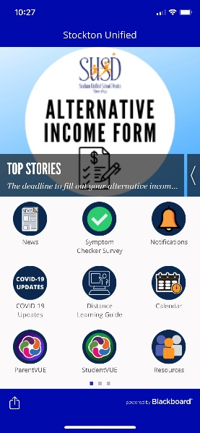
SUSD App
News – This button shows upcoming events that parents should be aware of
COVID-19 – Provides parents with the most up-to-date COVID info from SUSD
ParentVUE – Parent sign in to check their students’ classroom progress
The SUSD app has a lot of information, resources, and connectivity available for families and community members that can be explored. The app is free and can be easily navigated with practice.

Slide 8
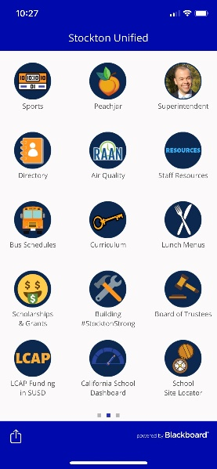
SUSD App (cont.)
Calendar – Shows a district-wide calendar of upcoming events
LCAP – SUSD stakeholders can learn about and provide feedback for district funds

Slide 9
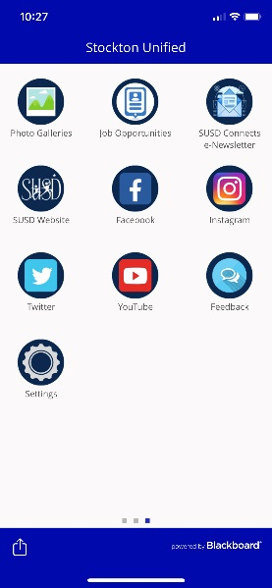
SUSD App (cont.)
Social Media – SUSD social media accounts for pictures, event fliers, district updates and resources
Resources – SUSD provides resources for district staff, families, and community members

Slide 10
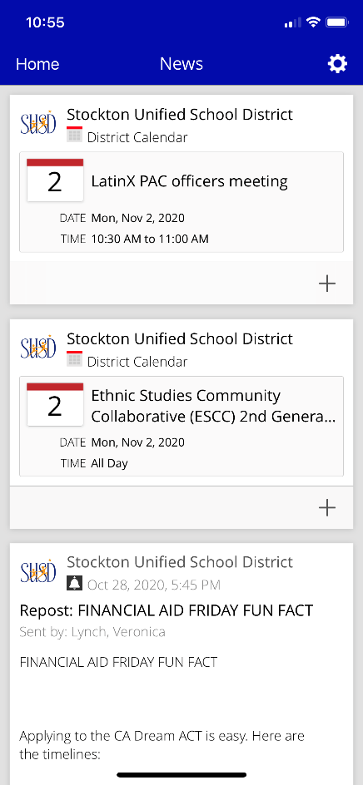
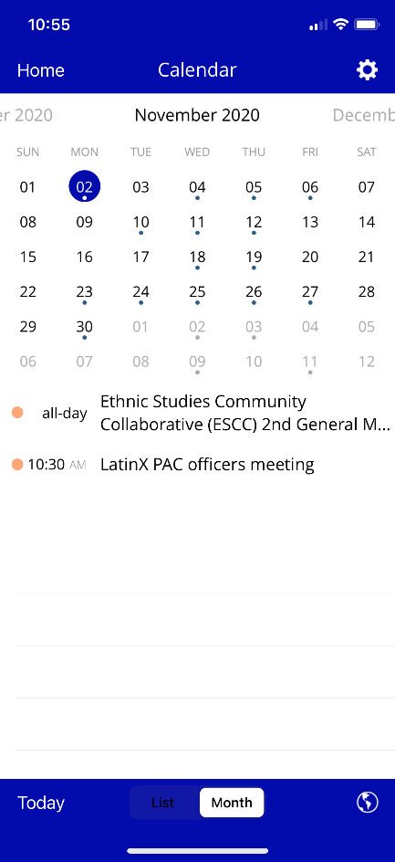
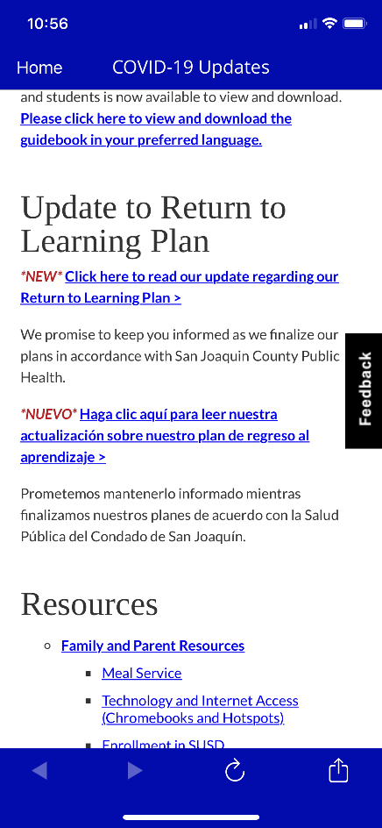
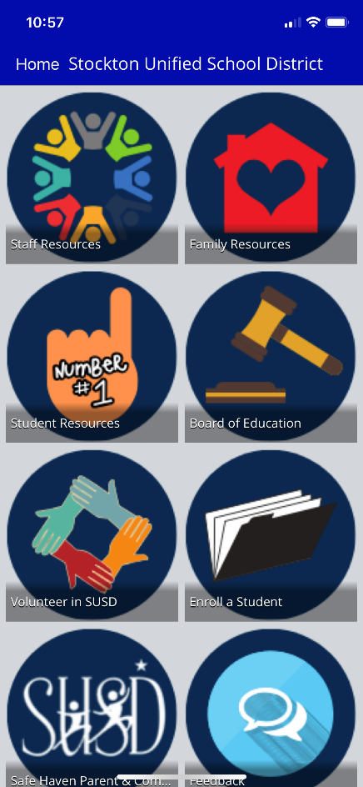
SUSD App (cont.)

Slide 11
Peachjar
Peachjar is a digital flier platform that creates ease for school districts to communicate and distribute fliers and event advertisements directly to parents. The use of Peachjar helps ensure that information coming from the school or community partners reaches parents by eliminating the chance for them to get lost in transit.
Pros:
Set it & forget it
Register directly from the flier
Direct contact info can be provided
Paperless (sustainable)
Downloadable/Printable

Slide 12
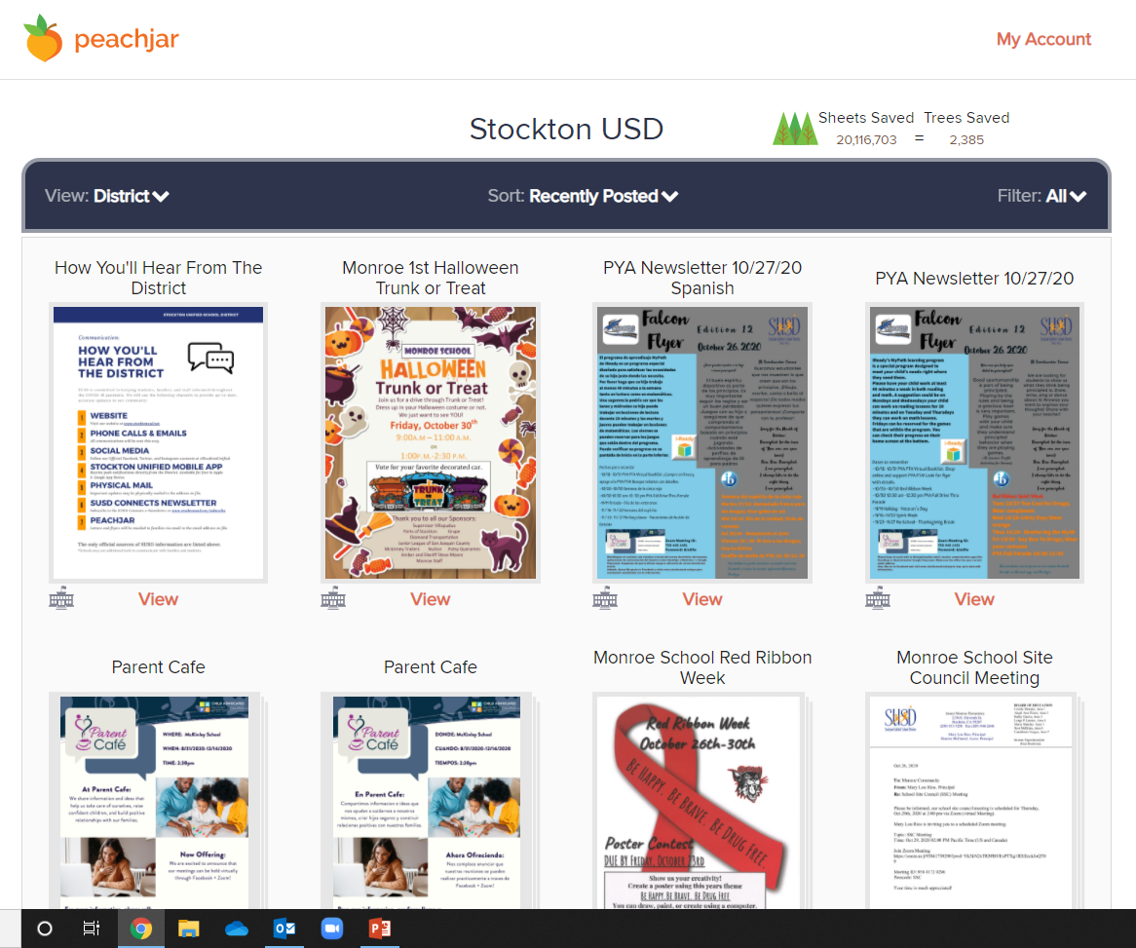
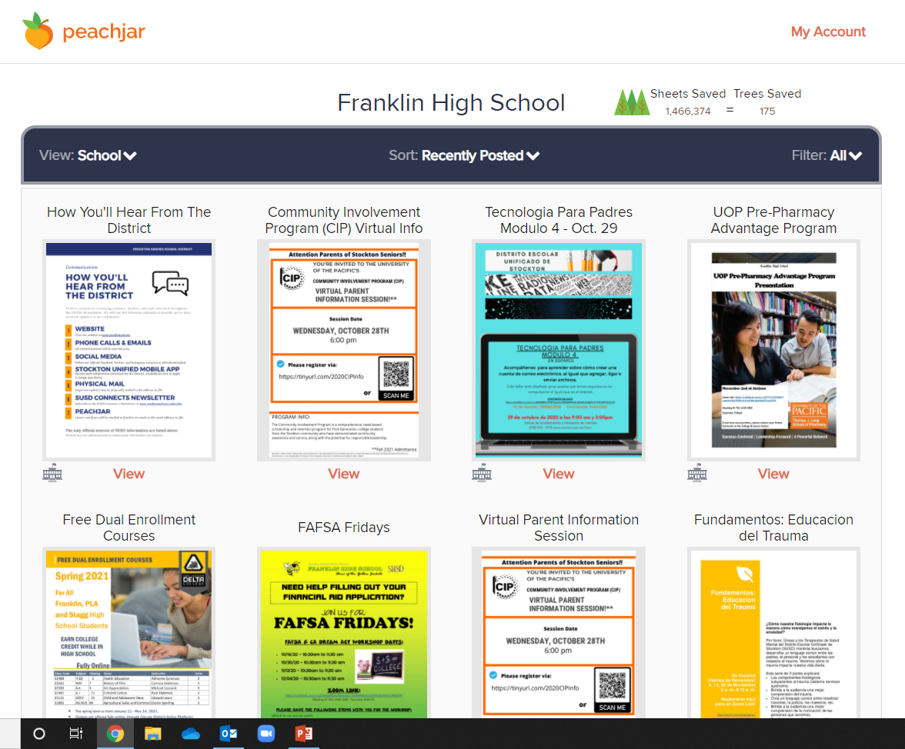
Peachjar

Slide 13
Questions

Slide 14
Review

Slide 15
Survey
Please take a few minutes to fill out the presentation survey. The surveys help improve future presentations and events.
Thank You!
-Family Engagement & Education

